Slide 1

Digital Security and Online Behavior
What is cybersecurity?
How can we protect our data?
How should we behave on the internet?

Slide 2
What is Cybersecurity?
Cybersecurity is the protection of information and systems on the internet.
protection against viruses
protection of personal data
ensuring the proper functioning of systems

Slide 3
Common Online Threats
1. Phishing
Phishing uses fake emails or websites to try to obtain personal data.
Warning signs:
urgent messages
suspicious links
spelling mistakes

Slide 4
Common Online Threats
2. Malware
Types of malware include:
viruses
Trojan programs
spyware
ransomware
How can it get onto a computer?
infected downloads
email attachments

Slide 5
Common Online Threats
3. DDoS attack
Occurs when many requests are sent to a server at the same time.
As a result:
the server becomes overloaded
the website stops working

Slide 6
Basic Protection Methods
Use strong passwords
Two-factor authentication
Firewall
Antivirus protection
Regular updates
Backup copies

Slide 7
A Few Simple Rules
Do not use the same password everywhere
Do not open suspicious emails
Update programs regularly
Use antivirus software
Make backups

Slide 8
Users' Rights
Right to information
Right of access
Right to erasure
Right to rectification

Slide 9
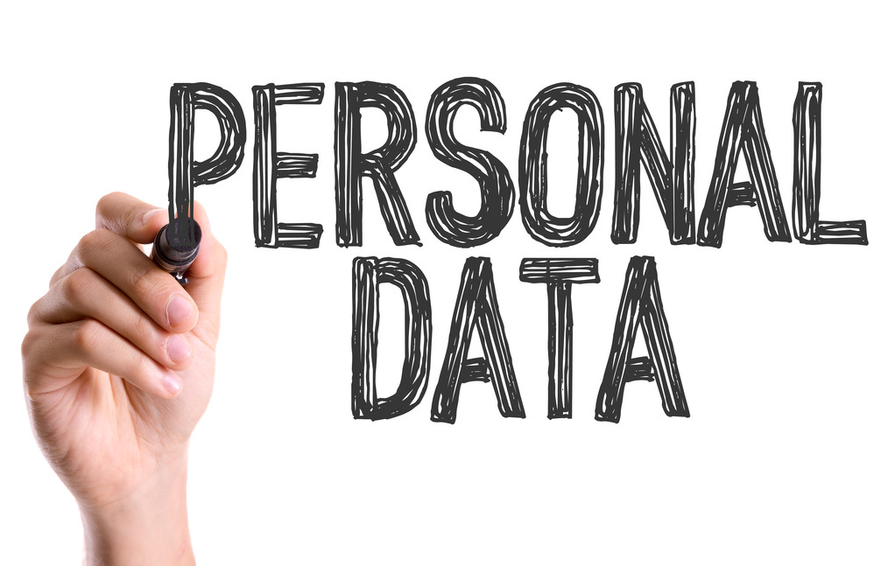
Personal Data
name
home address
phone number
email address
ID number
IP address
bank card details
health data

Slide 10
Protecting Personal Data in Everyday Life
Do not share too much information
Use strong passwords
Use two-factor authentication
Be careful about phishing

Slide 11
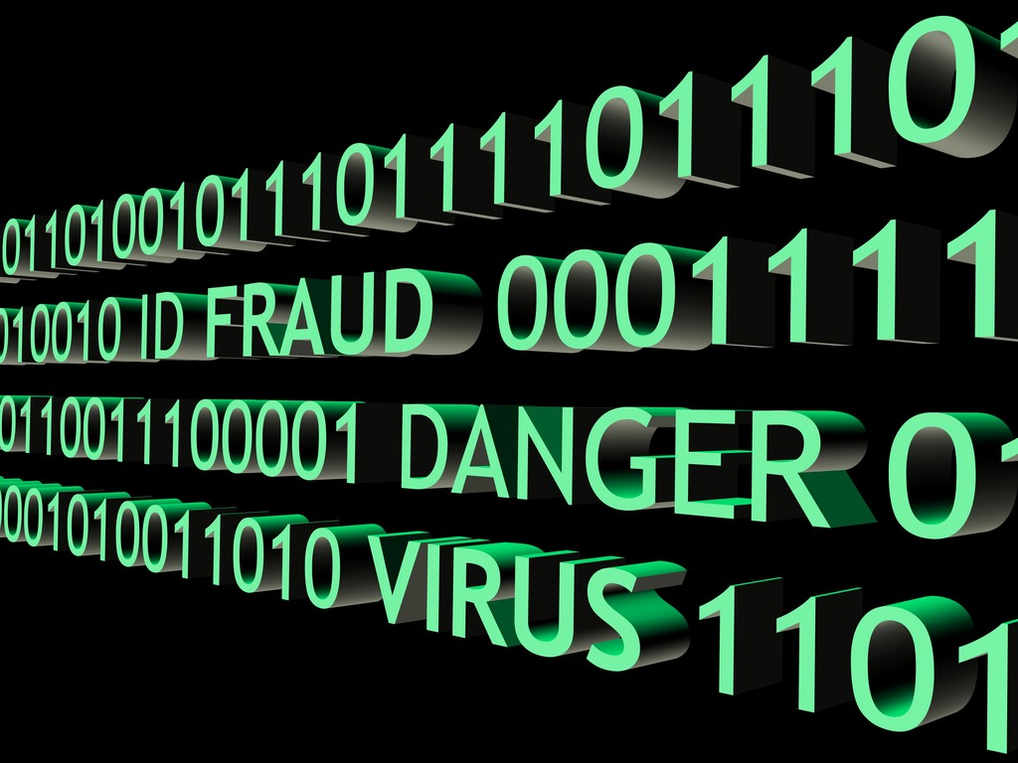


Strong Passwords
A good password should contain:
at least 8 characters
lowercase and uppercase letters
numbers and special characters
Example:
password123
K3s!G#98

Slide 12
Cyberbullying
sending insulting or threatening messages
posting humiliating pictures or videos
spreading false information about someone
excluding someone online

Slide 13
What Can We Do?
Do not respond to the bully
Save evidence
Report it on the platform
Block the bully
Tell a trusted adult or teacher

Slide 14
How Can It Be Prevented?
Think before sharing things online
Do not respond to insulting comments
Set privacy settings on social media
Do not share embarrassing content about others

Slide 15

Digital Footprint
A digital footprint is everything we leave behind online, such as:
social media posts
comments
uploaded images
search history
visited websites
It is important because it can remain online for a long time.

Slide 16
Types of Digital Footprint
1. Active Digital Footprint
posts on Facebook
comments on forums
profile data on websites
2. Passive Digital Footprint
IP address
browsing history
cookies
location data

Slide 17
How to Protect Your Digital Footprint
Think before you post
Use privacy settings
Do not share sensitive information
Use strong passwords and security protection

Slide 18
Digital Rights
Digital rights are basic rights and freedoms that people have in the online and digital environment.
Examples:
Right to data protection
Right to privacy
Freedom of speech on the internet
Right to access the internet
Right to digital security

Slide 19
What is Consent?
Consent occurs when a user voluntarily agrees that an organization can use their data for a specific purpose.
Conditions of Consent
Consent must be:
voluntary
informed
The user must know:
what data is collected
why it is collected
how it will be used
Consent must also be clear and unambiguous.

Slide 20
Where Do We Encounter Consent?
social media registration
online shopping
newsletter subscriptions
accepting cookies
If someone subscribes to a newsletter, they can unsubscribe later.
Why is Consent Important?
It helps to ensure that:
data processing is transparent
users control their own data
misuse does not occur

Slide 21
What Counts as an Online Platform?
social media (Facebook, Instagram, TikTok)
forums
online games
comment sections
messaging applications

Slide 22
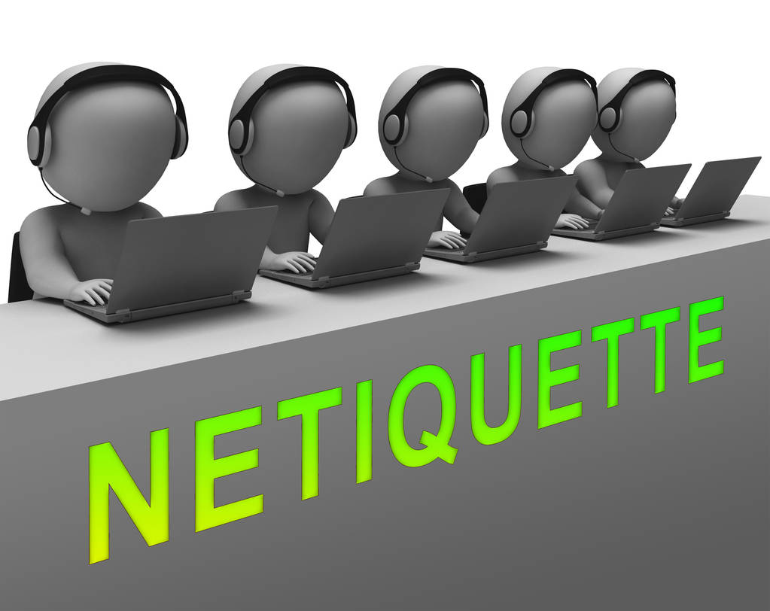
Respect on the Internet
Rules (Netiquette):
do not insult others
communicate politely
respect others' opinions
do not spread false information
ask permission before sharing images

Slide 23
Rules of Online Communication
Be polite in comments
Respect other people's opinions
Do not use offensive language
Think before posting
Do not share other people's personal data

Slide 24
Summary
Protect your personal data
Use strong passwords
Pay attention to online behavior
Think carefully about what you share online

Slide 25
PROTECT

Slide 26
YOUR

Slide 27
DATA

