Slide 1

eSafety in Finland
Current situation (2026)

Slide 2

Introduction
Finland is a leading digital society with strong media literacy.
Cybersecurity and digital resilience are national priorities.
Key challenges include misinformation, hate speech, scams, and AI-related risks.
Notes:
Introduce Finland as a global leader in digital literacy while highlighting emerging online risks.

Slide 3
Internet Use by Age Group
(Illustrative National Trends)
Notes:
Internet adoption is extremely high across Finland, supporting digital participation.

Slide 4
Digital Society in Finland
Broadband and digital public services are widely available.
Online banking, e-government, and digital education are common.
Digital participation is among the highest in Europe.

Slide 5
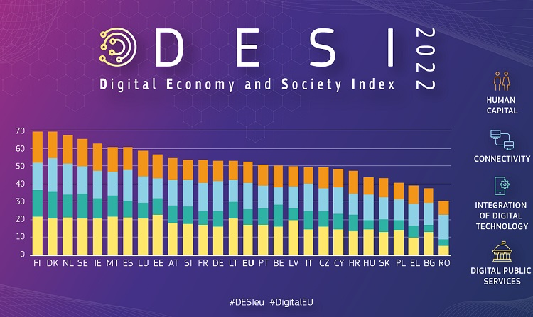

Slide 6
Key eSafety Challenges
Online hate speech and harassment.
Disinformation and manipulated content.
Phishing, fraud, and cybercrime.
Privacy and data protection concerns.

Slide 7
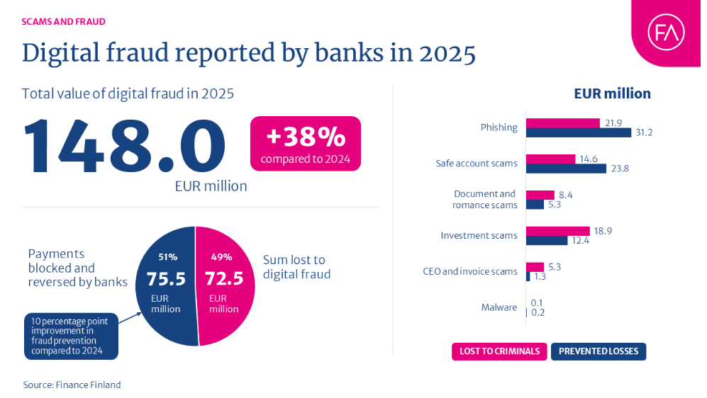

Slide 8
Major Online Risks in Finnland

Slide 9
Youth Online Safety
Young people are intensive users of digital platforms.
Schools teach digital literacy and responsible online behavior.
Cyberbullying and mental wellbeing remain concerns.

Slide 10

Youth Online Safety
- Young people are intensive users of digital platforms.
- Schools teach digital literacy and responsible online behavior.
- Cyberbullying and mental wellbeing remain concerns.

Slide 11

Cybersecurity Strategy
- National Cyber Security Strategy updated in recent years.
- Focus on resilience, preparedness, and public-private cooperation.
- Cybersecurity viewed as part of national security.

Slide 12
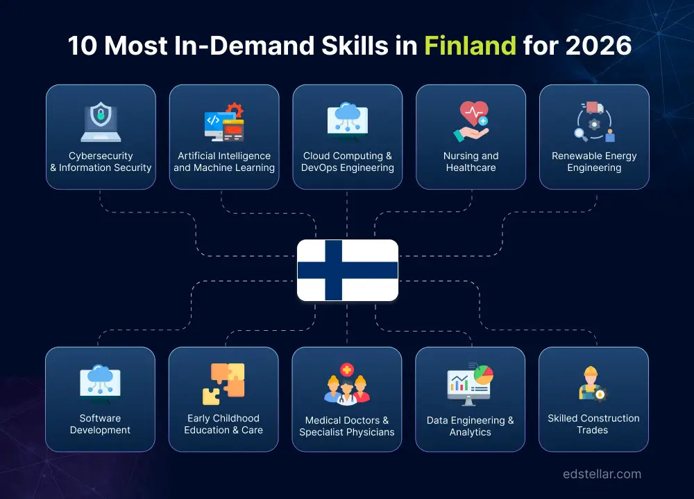
Artificial Intelligence and Emerging Risks
- Generative AI increases misinformation risks.
- Need for verification and critical thinking skills.
- Organizations are developing AI governance frameworks.

Slide 13

Business Perspective
- Organizations invest in cybersecurity awareness training.
- Compliance and data protection remain priorities.
- Human error continues to be a major risk factor.

Slide 14

What to do?
Expand digital literacy education.
Strengthen anti-bullying and reporting systems.
Increase awareness of scams and fraud.
Promote responsible AI use.

Slide 15
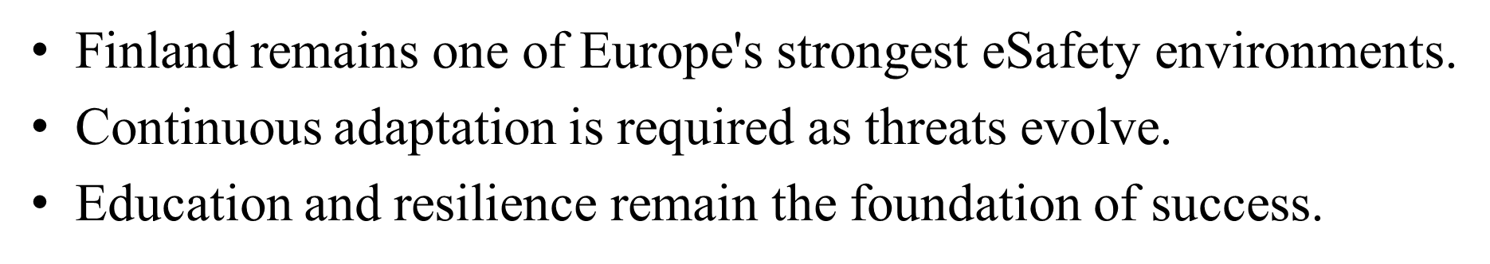

Summary

Slide 16
References
Statistics Finland
Finnish Transport and Communications Agency (Traficom)
National Cyber Security Centre Finland
European Commission Digital Economy and Society reports
OECD digital society publications

Slide 17

Thank you for watching!

