Slide 1

New generation promoting sustainable devolopment goals
"Greta Thundberg"
By Noora, Samu and Aada

Slide 2
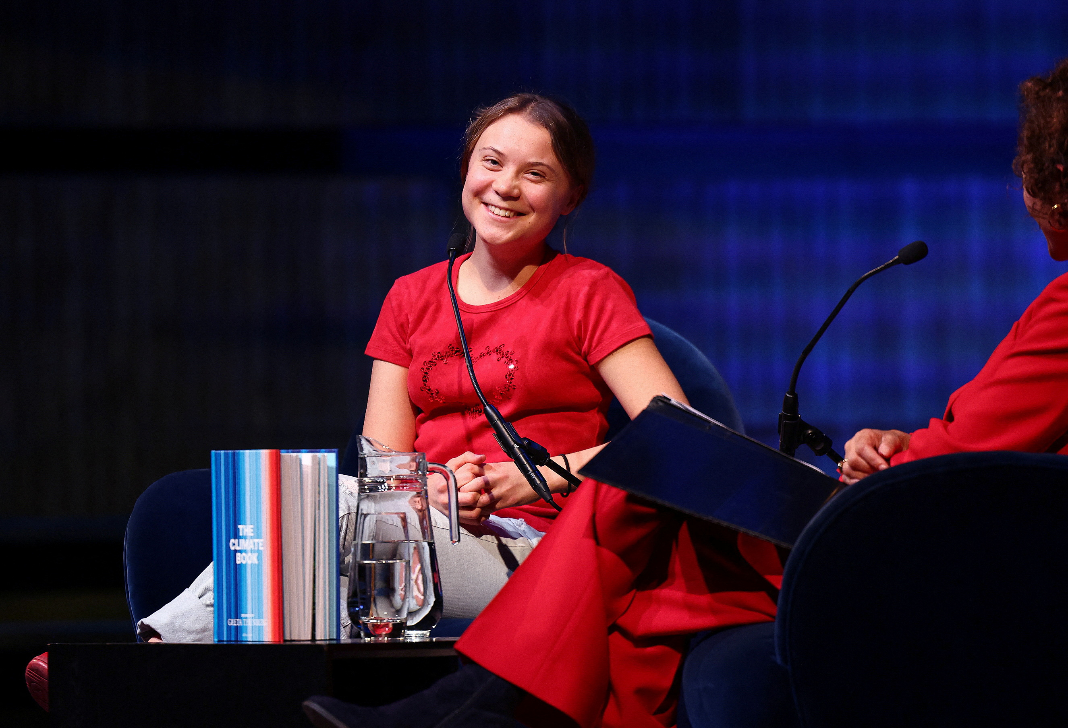
Greta Thunberg
22 years old Greta Thunberg is swedish climate activist. She is known for bringing her ideas about climate changes to the world´s decision makers. For example she has been promoting her opinion about climate changes in front of Swedish Parliament Building, Stockholm.

Slide 3

Her childhood
Greta was born on the third of January. Her mother is an opera singer, who has represented Sweden in Eurovision song contest in 2009. Gretas father is an actor, producter and writer. She has sister who is three years younger, who has created a career as a singer. When Thundberg was nine years old she started to pay attention to climate change. Thats when she quit eating meat and buying anything useless. In 2015 she stopped traveling by plane, this decision also affected her mother. Family of Thundbergs grow their own vegetables in their pot. They live in outside the city and they get their energy from solar panel.

Slide 4
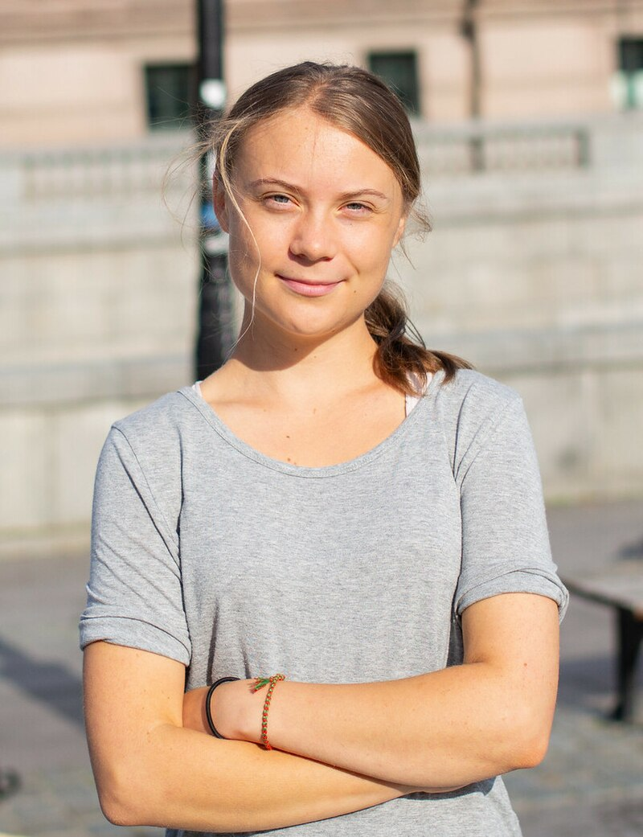
Can activism improve your life?
Greta has been diagnosed with Asperger's syndrome. It is a neurological developmental disorder and it´s one of the autism spectrum disorder also. She considers her diagnosis a "superpower" because it helps her stay focused on her goals and not fear criticism. A few years before she started climate activism, Greta suffered from depression. Her father has said that Greta didn´t want to go to school or eat anything. But since she started climate activism. However, activism has made Greta happy later.

Slide 5
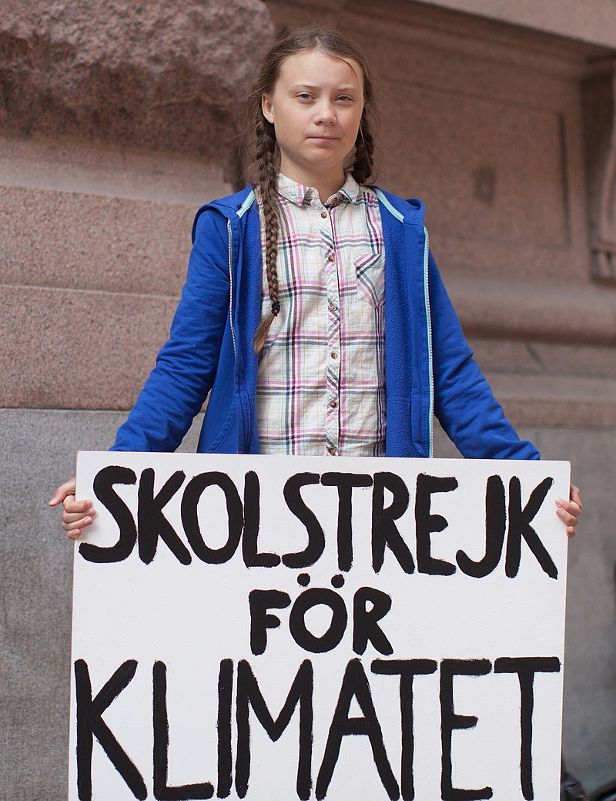
Activism – What Greta has done
In may 2018 Greta was one of the three winners of the climate-related writing competition. The competition is organized by Svenska dagbladet, and it´s for young people.
When Greta was 9th grade she said "I won't go to school before the Swedish parliamentary elections.." Instead of She spent her school days sitting in front of the Swedish parliament building. Greta was carrying a sign that read: Skolstrejk för kilmatet. ( School strike for climate). Her goal was to push the Swedish government to act in line with the Paris Agreement.
Gretas school strike inspired many other students around the world. That grew into a global citizen movement.

Slide 6
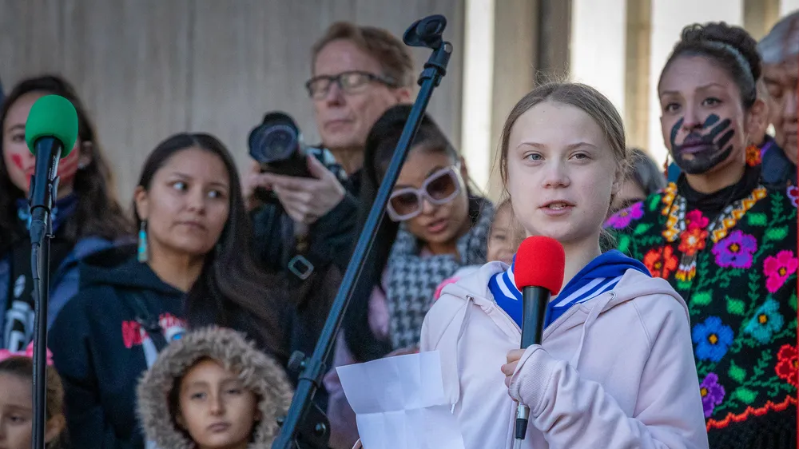
Greta has spoken at several international climate conferences, including the UN Climate Summit in 2019. Her famous "How dare you?" speech criticized world leaders for failing to act on climate change. She accused politicians of making empty promises and prioritizing economic interests over the environment and future generations. Her direct and emotional speech gained global attention and reinforced her role as a leading voice in climate activism.
Greta’s activism has influenced many governments to adopt stricter climate policies and has inspired new laws and political commitments. The European Union, for example, has strengthened its climate goals, and many countries have pledged to reduce their emissions faster. She has also impacted the corporate world, with many major companies prioritizing sustainability in response to public pressure.

Slide 7

Criticism
Although Greta has received so much support, she has also faced criticism. Some politicians and business leaders have dismissed her, claiming she is too young to understand economics and political issues. Others have criticized her emotional speeches and direct communication style. Climate change deniers and conservative groups have also attempted to undermine her message.
For example:
Some political leaders like U.S.A President Donald Trump sarcastically tweeted that Greta should “chill and go to a movie.”
Vladimir Putin has condemned teenage climate change activist Greta Thunberg, claiming she is "poorly informed" and does not understand complex global issues.

