Slide 1
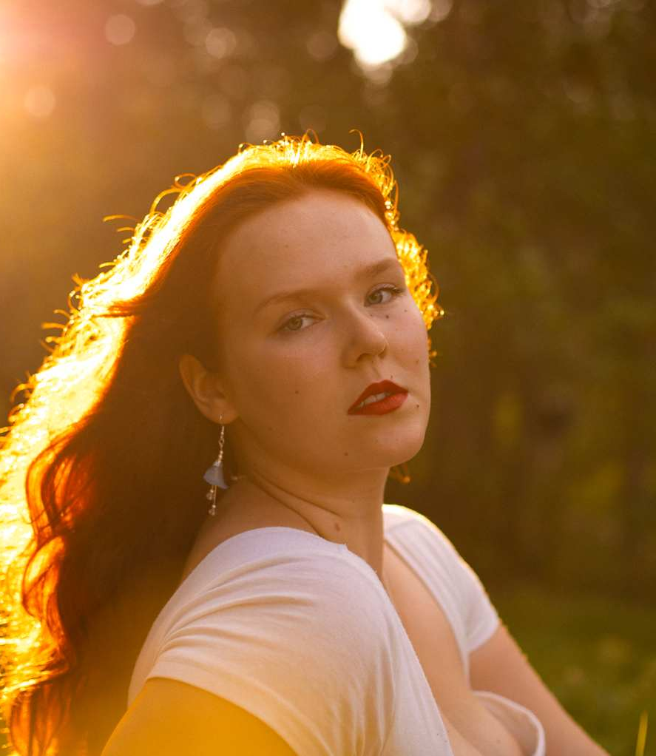
Hanna Höijer
Hanna Höijer, 20 years old is working with the climate change. She's the youngest youth delegate in the world. Hanna has led numerous youth organizations, initiatives and programs all focusing on leveraging the potential of our generation in changing the world.

Slide 2
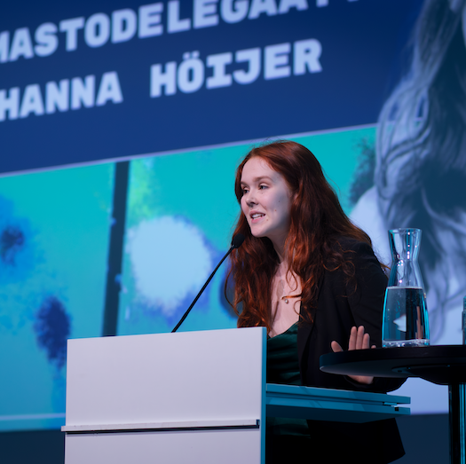
Hanna's career
Hanna is a member of the Finnish UN Youth. She participated to the climate change conference in Glasgow, Scotland (cop 26) and the UN climate talks in Dubai, United Arab Emirates. The meeting decided that the use of fossil fuels will end by 2050. She has also worked at the Baltic Sea Foundation.

Slide 3
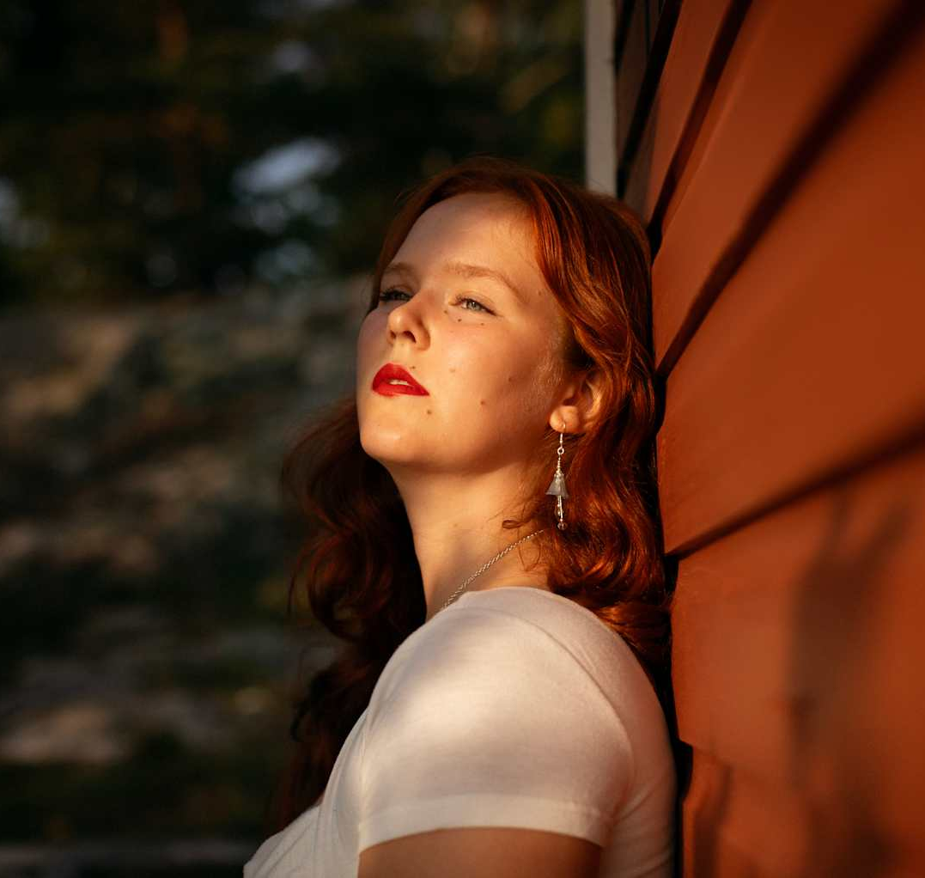
Inspired by her mother, Hanna has been interested in climate issues since she was young. She was able to attend climate change events because her mother is part of the Ministry of the Environment. Hanna listened to her mother's speeches and lectures when she was young and is also the only one of her siblings who has always been interested in her mother's work and the climate change.

