Slide 1
Ilkka Hanski
Finnish progressive ecologist

Slide 2
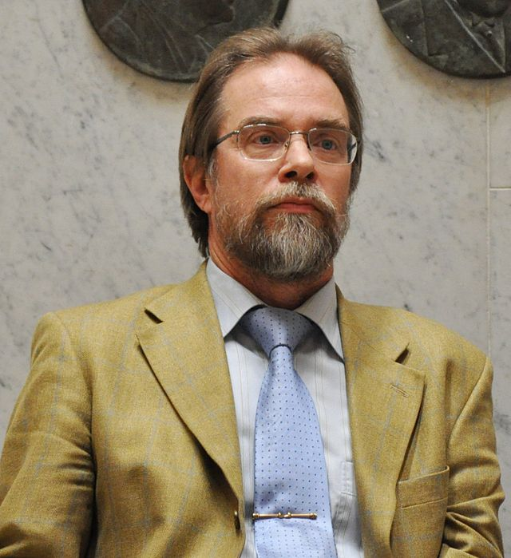
Early life and education
Ilkka Hanski was born in 1953 in Helsinki. He had an early interest in nature and science. He studied biology at the University of Helsinki, receiving his bachelor's degree in 1974 and his master's degree in 1976. His doctoral dissertation, completed in 1981, dealt with the ecological and evolutionary characteristics of Finnish butterfly populations. His early research focused particularly on insects and the ecological interactions of butterflies.

Slide 3
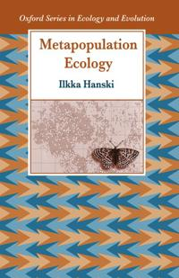
Metapopulation theory
Ilkka Hanski's most significant scientific achievement was the development of metapopulation theory and its application to practical ecology. A metapopulation is a group of several subpopulations, where these populations can live in different isolated areas, but there is mobility and interactions between them. This model explains how species can survive in areas where habitats are disrupted or unstable, such as on islands or after forest fires. In his research, Hanski specifically studied the behavior and mobility of butterfly populations, and how these populations adapt to environmental changes. He discovered that metapopulations can be more stable and viable, even if the individual populations are small and isolated from each other. This observation was significant, as it helped to understand broader ecological processes, such as the risk of species extinction and regional biodiversity.

Slide 4
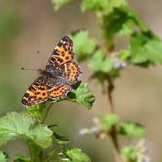
The Great Butterfly Project
One of Hanski's most famous research projects was a long-term study of butterfly populations in Finland, especially in areas near the Helsinki Metropolitan Area. He and his research team monitored the life, movement, and population dynamics of butterflies for decades, and this research was central to the development of metapopulation theory. This "Great Butterfly Project" was one of the world's longest-running ecological field studies and helped Hanski understand how species can adapt to environmental changes.

Slide 5
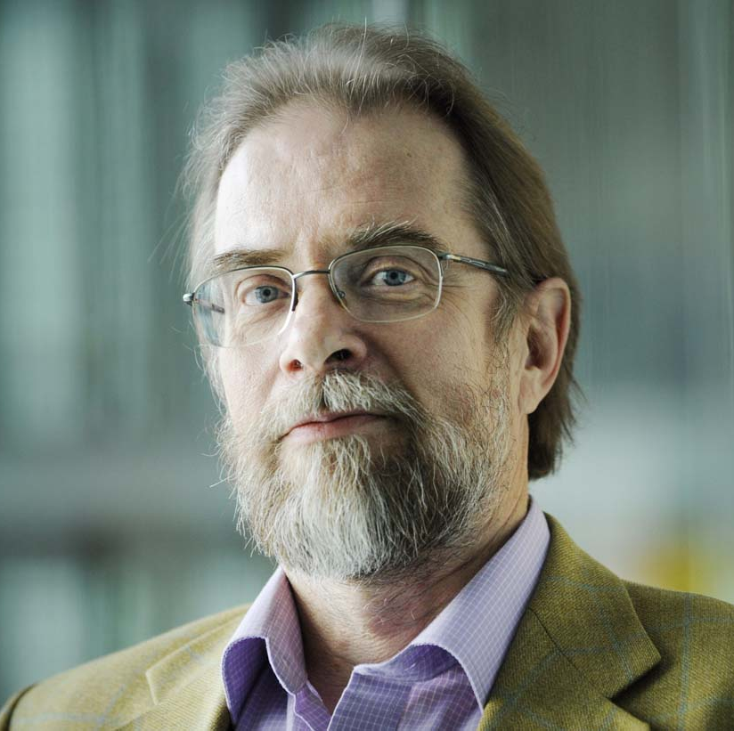
Significance for nature conservation and ecology
Hanski was not only a theorist, but his research also influenced practical conservation. He highlighted the importance of maintaining ecological connections and ensuring the ability of species to move between habitat patches. This is especially important in today's world, where habitats are fragmented as a result of land use changes, such as deforestation and urbanization. Hanski also actively spoke out in favor of biodiversity protection and participated in many international research programs that investigated the importance of biodiversity for the functioning of ecosystems.

Slide 6
Final years and legacy
Hanski continued his research work actively until his death. He published over 300 scientific articles and several books, one of the most famous of which is Messages from Islands, in which he described the importance of island ecology and metapopulation biology.
His legacy lives on through both his theories and the researchers he trained. The Center of Excellence in Metapopulation Biology at the University of Helsinki continues his work, and his research continues to provide important information for the development of nature conservation and ecology.

Slide 7
Sustainable development
Ilkka Hanski is involved in sustainable development through the protection of biodiversity. His research on habitat fragmentation and species survival contributed to understanding the resilience of ecosystems and the importance of conservation. Hanski emphasized that biodiversity is vital to human well-being and that its preservation is a central part of sustainable development. He also promoted practical nature conservation, such as through Ilkka Hanski's Nature Network, which secures valuable natural areas for future generations.

Slide 8
Sources
https://www.aka.fi/
https://fi.wikipedia.org
https://www.kirjasampo.fi

