Slide 1
What are human rights?
Human rights are a set of fundamental rights that all people possess simply by virtue of being human beings. These rights are universal, inalienable, and indivisible, which means they apply to all people, everywhere, at all times, and cannot be negotiated or waived.

Slide 2
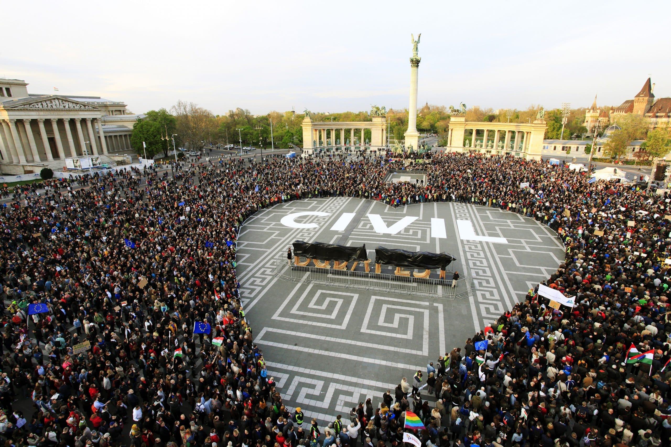
HUNGARY AND HUMAN RIGHTS
Human rights in Hungary are governed by the Constitution of Hungary, laws passed by the National Assembly, and oversight of international organizations such as the Council of Europe. Human rights groups such as Amnesty International and Human Rights Watch have raised concern for the status of human rights in Hungary under the rule of Viktor Orbán and the Fidesz party since 2010.
.

Slide 3

we must stand up for human rights
Human rights are the basis of our democracies. To defend them is to defend freedom and to support the European project in wich we are involved.

Slide 4
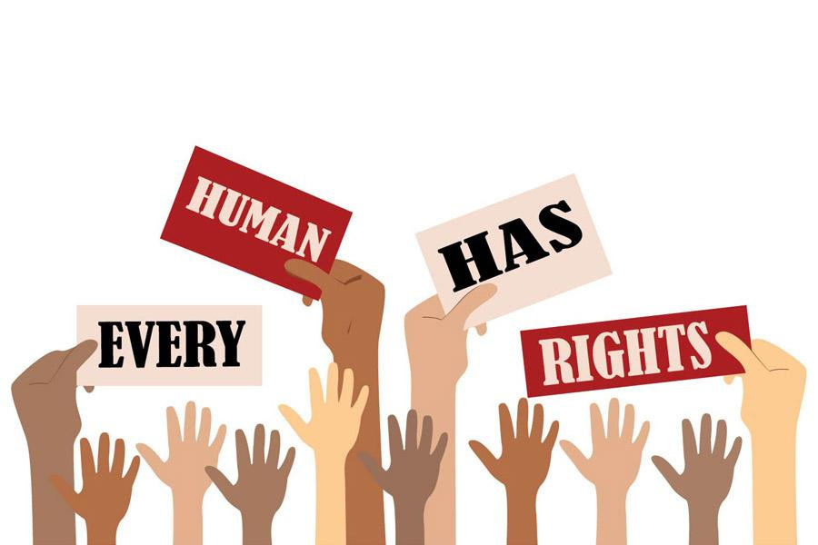
thank you!

