Slide 1
Human RIGHTS Activists IN HUNGARY

Slide 2
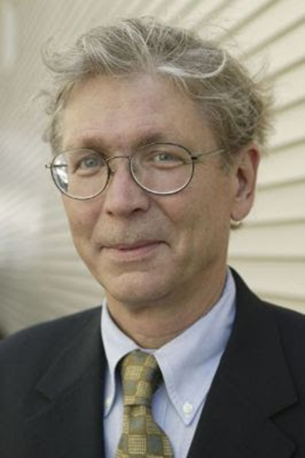
Mr László HÁMOS
He persuaded American politicians to elevate for the sake of the Hungarian minorities.
He made documents about violations.
The foundation kept in touch with the Hungarian underground movements in Romania-Transylvania and collected, translated and published first-hand news.
co-founder of the Committee for Human Rights in Romania (Commission for Human Rights in Romania)
From 1984 Hungarian Human Rights Foundation, which he ran for 43 years.

Slide 3
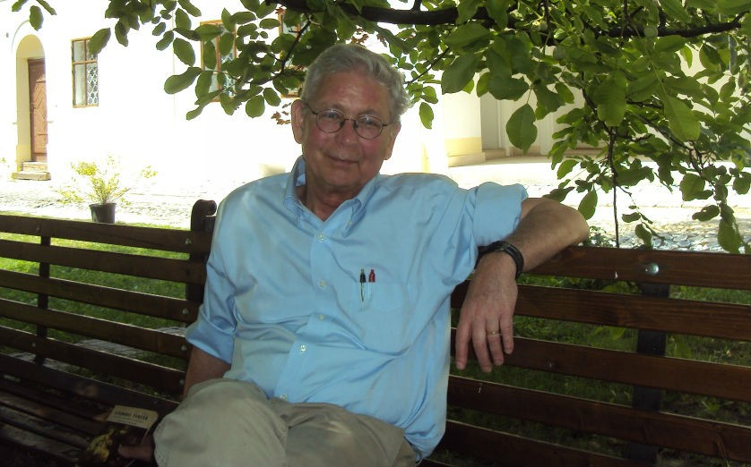
The foundation received practicants from all over the world in New York and Washington.
Many of them later chose law enforcement as their profession

Slide 4
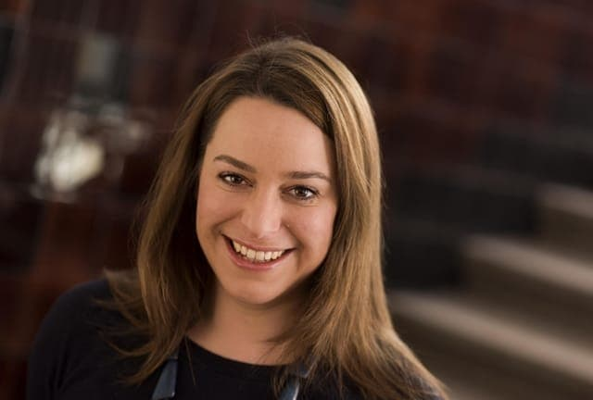
Miss Márta Pardavi
Co-president of the organization since 2007.
Member of the Bureau and Vice-President of the European Council on Refugees and Exiles (ECRE)
She is currently a board member of the PILnet Foundation, an international NGO promoting the protection of human rights among prospective and practicing lawyers
Hungarian Helsinki Committee
a civil rights organization, a non-profit association that protects human dignity through law and publicity and provides assistance to refugees, detainees and victims of official violence

Slide 5
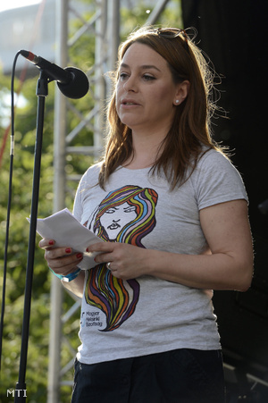
She received the Human Rights First Human Rights Award in New York:
For her sacrificial work for the rights of refugees, migrants and other groups in Hungary and in Europe.

Slide 6
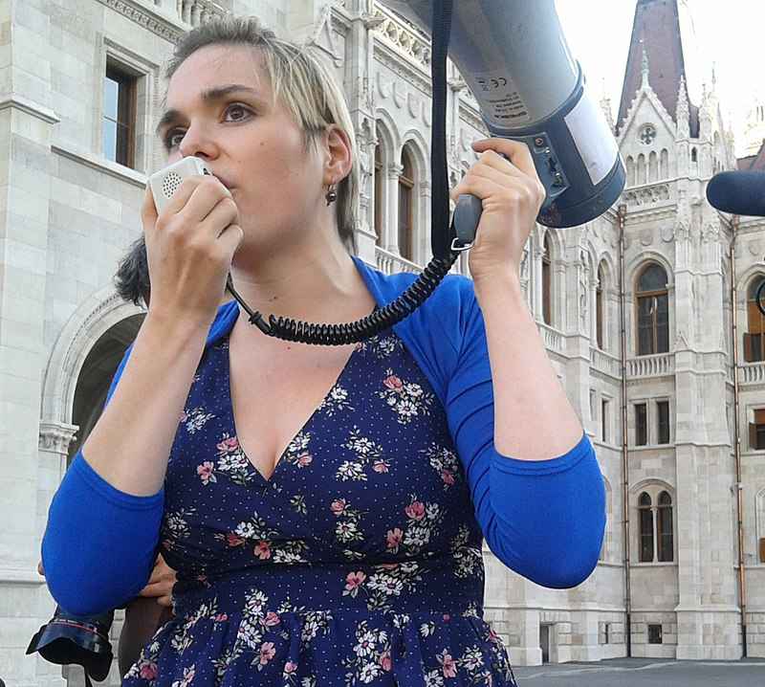
Miss Réka Kinga Papp
As a journalist, her special topics are in environmental, human rights and human rights issues, mainly web videos.
She is an editor of Eurozine magazine.
Club Radio Professor's show Paprika.
She hosted the political video show with the title „Half-half”.

Slide 7
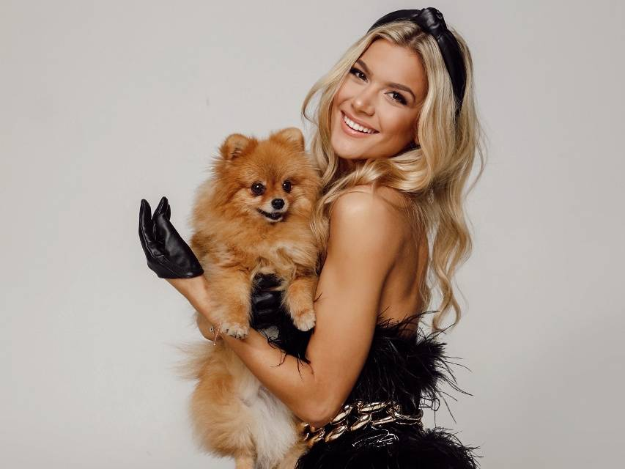
Miss Fanni Weisz
A deaf mute photo model, beauty queen, equal opportunity activist.
She started an education program called the Voice of Silence
Europe's first deaf speaker for the African-Hungarian Association in 2012 to help disadvantaged people
Interpreter for deaf mute people of the New Year's speeches of Mr President János Áder

