Slide 1
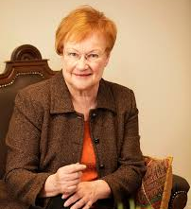
Tarja Halonen
Tarja Kaarina Halonen Finnish politician.
Born. 24.12.1943

Slide 2
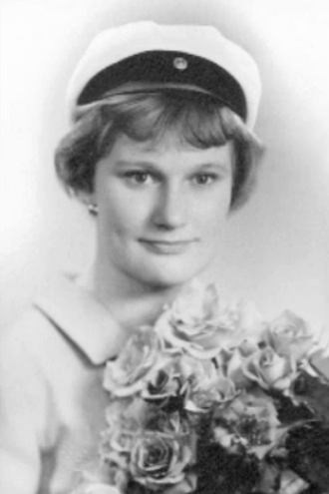

Early life and career.
Tarja Halonen began her studies in Kallio elementary school in 1950 from where she later moved to Kallio Gymnasium and finished her matriculation examination in 1962. She started to study art history in the university of Helsinki but in 1963 autumn she changed her studies to law and obtained her Master of laws degree in 1968.

Slide 3
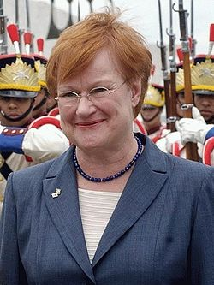
Political career
Halonen joined the Social Democratic Party in 1971 that had close ties with the trade unions where she had worked as a lawyer from 1970 to 1974. She was a member of social democratic party from 1971 to year 2000 when she became first female president of Finnland and only woman to hold that position from March 1 2000 to March 1 2012.

Slide 4
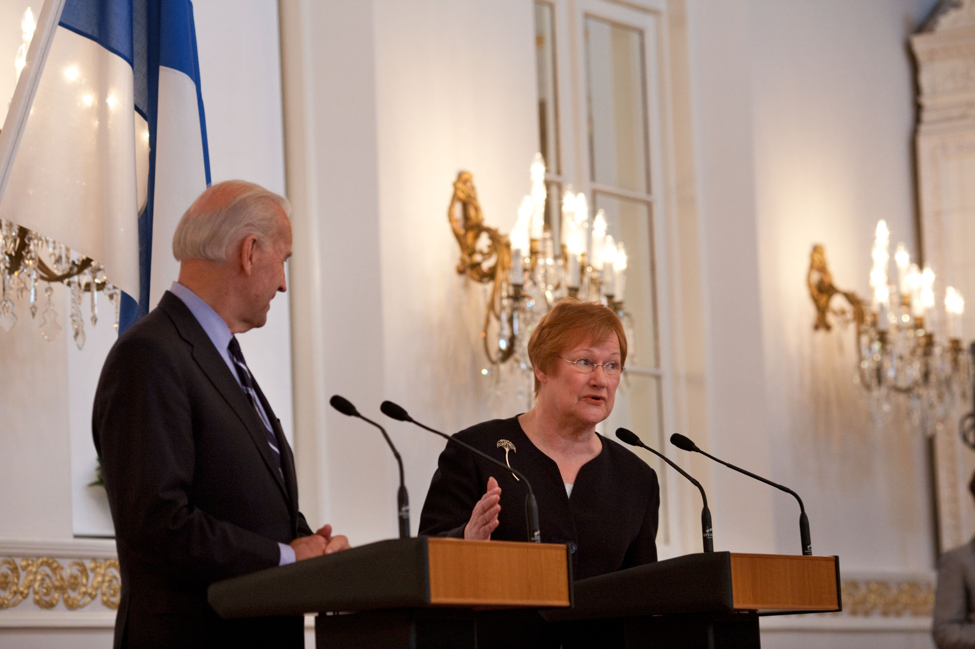
Domestic politics
She was active LGBT rights activist for long and, in early 1980s she worked a chairwoman of the sexual eguality association [seta].she supports egual marriage laws
Halonen supported the removal of landmines by the finnish military.and land mines were removed due to her decisive actions in 2011

