Slide 1
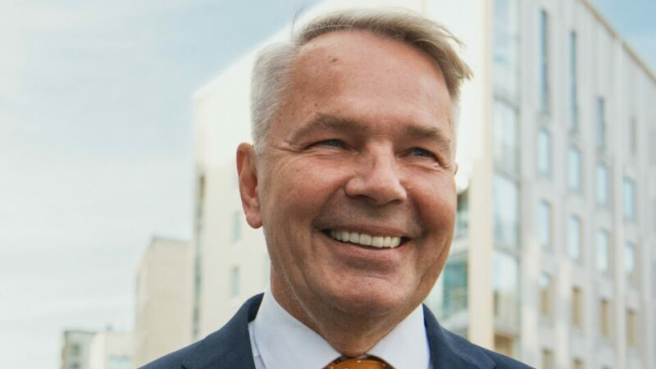
Pekka Haavisto
Matilda Niskanen and Nadja Pehkonen 9b

Slide 2
Finnish human rights activist Pekka Haavisto.
Pekka Olavi Haavisto is a Finnish politician who served as Minister of Foreign Affairs of Finland from 2019 to 2023. Haavisto served as a member of parliament for the Green League from 1987 to 1995 and again from 2007, and as chairman of his party from 1993 to 1995 and 2018 to 2019.
He has been a presidential candidate no less than 3 times. In 2012, 2018, and 2024. Each time he has made it to at least the second round, but has not been elected.

Slide 3
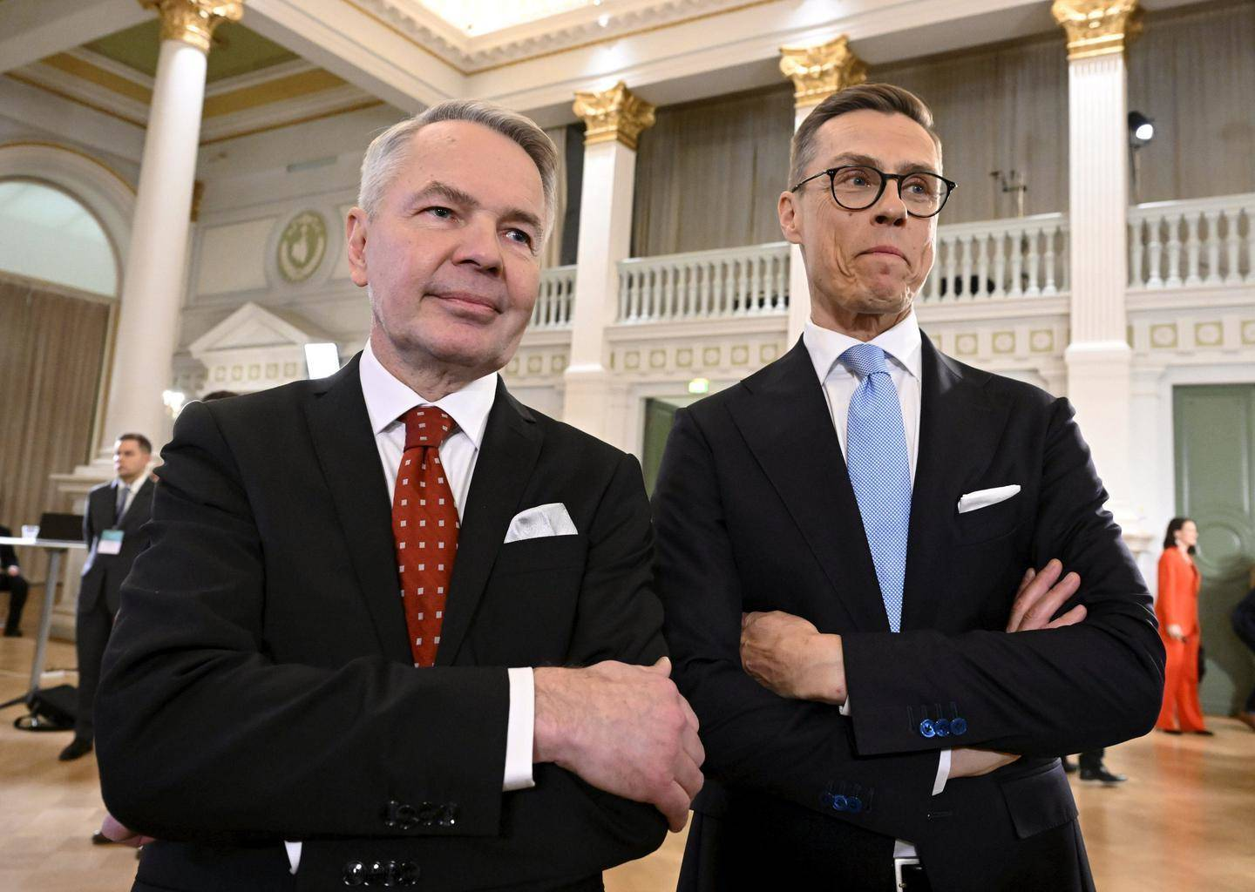
"Human rights are no longer just an ornament on the edge of a paper, but the defense of global values that are important to us. Finding allies in defending those values also increases our own possibilities for action and our own security."
Pekka Haavisto

Slide 4
Personal life
Haavisto met her husband, Nexar Antonio Flores, a barber and hairdresser from Ecuador, in 1997 while traveling in Bogotá. They began their relationship in 2002.
Haavisto lives in a detached house in Kulosaari, Helsinki.
Haavisto is openly gay and a vegetarian
He is also a DJ, under the name DJ Pexi

Slide 5
Representative of green and liberal values
Pekka Haavisto is a representative of green and liberal values. Haavisto has represented values that support minority rights, sexual equality and tolerance. He is openly homosexual and has been a pioneer in defending the rights of sexual and gender minorities in Finnish politics. His presidential campaigns (2012 and 2018) also raised human rights issues into public debate.

Slide 6
International peace mediation and conflict zones
Haavisto has worked in UN and EU special operations in crisis areas, such as Sudan, Somalia, the Middle East and the Horn of Africa. He has participated in peace negotiations and worked in post-conflict reconstruction. In these roles, human rights have been at the center, especially the protection of civilians and the right of people to live free from harm and violence.

Slide 7
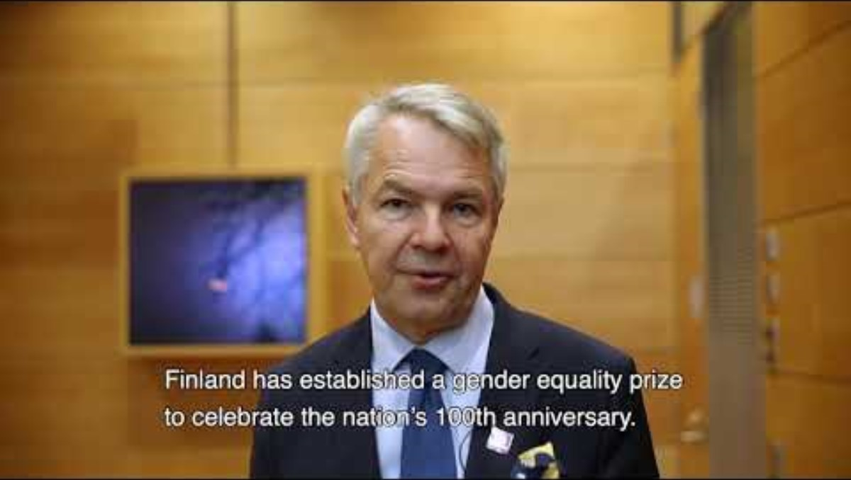

Slide 8
Haavisto dares to speak
Haavistos actions and views have attracted both praise and criticism. On the one hand, he has received widespread appreciation for his courageous and unyielding stances, but on the other hand, his approaches have also caused some political disagreement.
Pekka Haavisto is one of those Finns who have raised Finland's defense of human rights and global justice in the international debate. His role as a human rights activist has been significant both in the Finnish and global contexts.

Slide 9
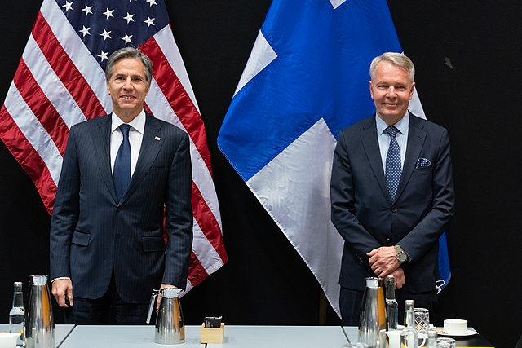
Pekka Haavisto
"Value-based and interests can also come together in foreign policy, and this is how I personally experience human rights-based policies. We defend a world order in which we have room to maneuver, and in which we ourselves can maintain peace, stability and prosperity."

Slide 10
sources
https://fi.wikipedia.org/
https://www.paavovayrynen.fi/
https://chatgpt.com/
https://www.iltalehti.fi/

Slide 11
Sources of images and videos
https://kuntalehti.fi/
www.facebook.com
https://www.youtube.com/watch?v=5MEWmKHj5s8

