Slide 1
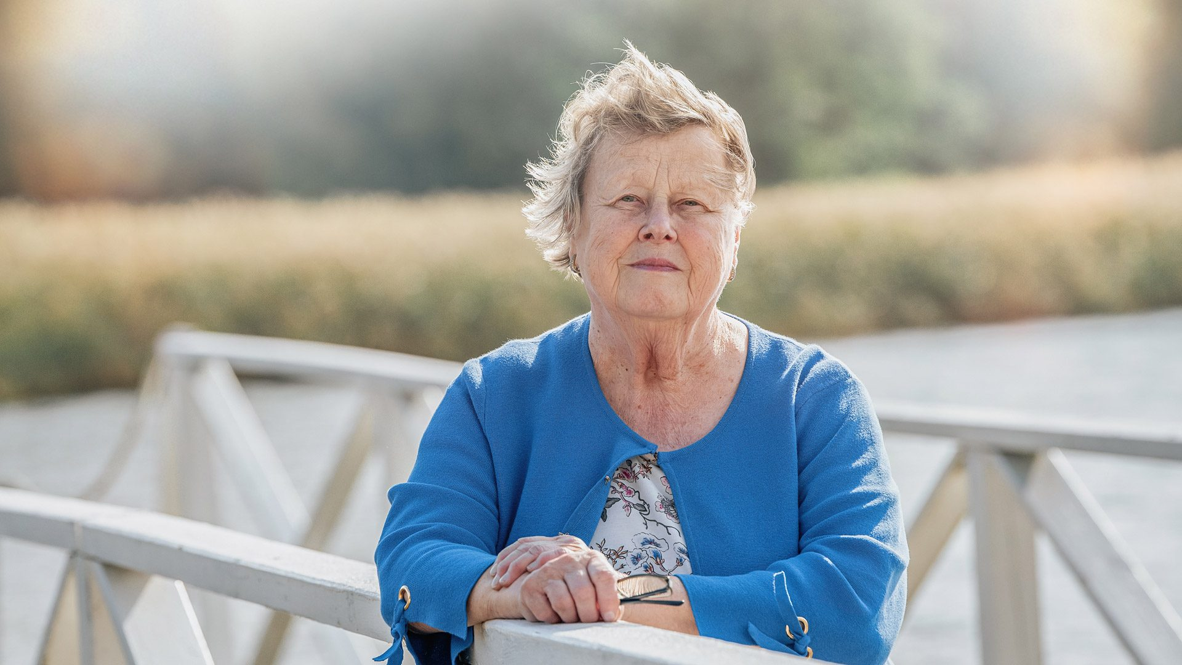
Helena Ranta
A medical forensic expert who has investigated human rights crimes and helped victims.

Slide 2
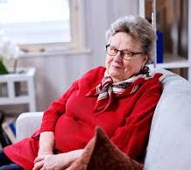

When Helena Ranta started her journey as an human rights defender and her age
Helena Ranta is currently 79 years old, she was born in 1946 on the 11th of june.
From the year 2001 she started working as a forensic dentist in Helsinki's university and has worked with or been the leader of forensic medicen groups

Slide 3
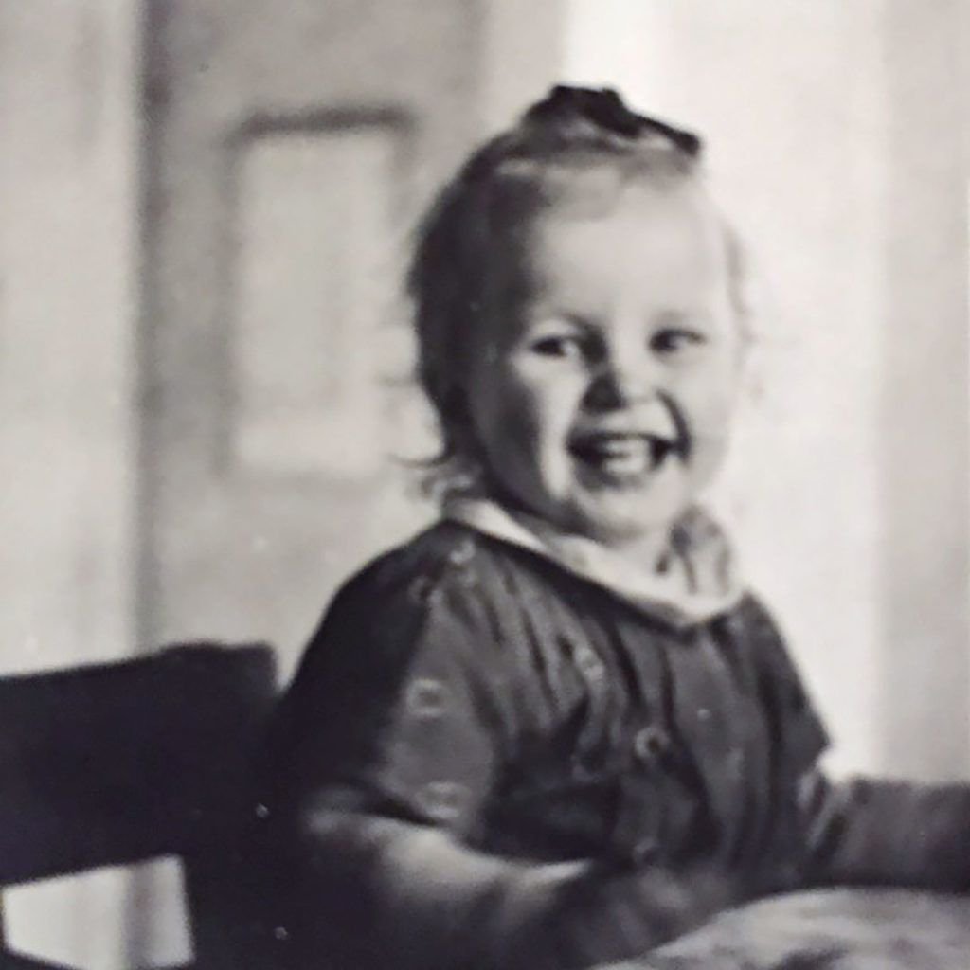
Helena's childhood
Helena had a safe childhood, her parents adored their beautiful, curly-haired youngest daughter. Helena's age difference with her older siblings was just right, and they also knew how to find joy in their little sister. Helena's family moved to Imatra when she was 5 years old, because of her father's work.

Slide 4
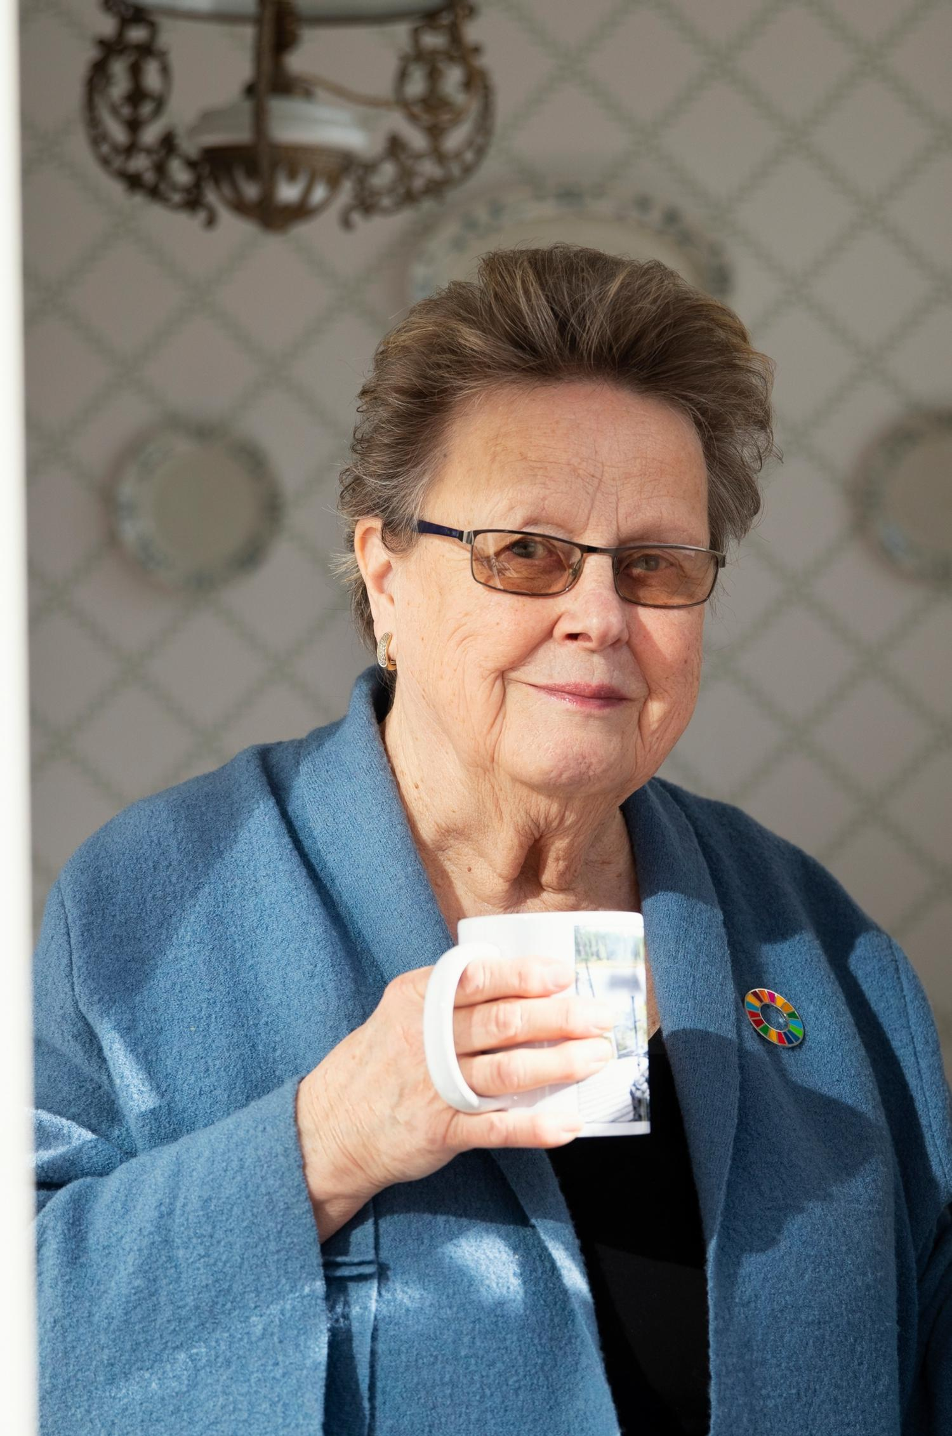
Helena's journey to becoming a dentist
In 1965, Ranta graduated from high school and started studying dentistry at the University of Helsinki in the same year. Ranta graduated as a student dentist in 1972 and then worked for a while as a private dentist before transitioning to research. She pursued postgraduate studies in Bristol, England from 1976 to 1977 and earned her doctorate in 1978. Ranta became the chief dental officer of the Ministry of Justice in 1989. In 1993, she worked as a researcher in Norway. Ranta identified the victims of the Estonia disaster in 1994. From 2001, she served as a forensic dentist at the Institute of Forensic Medicine at the University of Helsinki.

Slide 5
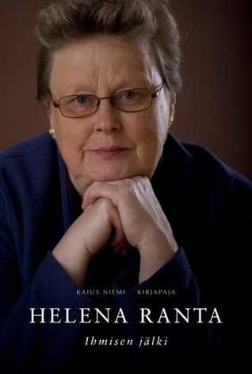
Helena Ranta's family
Helena had two husbands during her life. First husband was Kari Ranta, whom she has met in the liberal group of student union. But however, marriage was childless and ended with divorce.
She have a husband named Jukka, who was a friend from university in Imatra.
However Helena doesn't have children but its not her choice, because she cant get them.

Slide 6
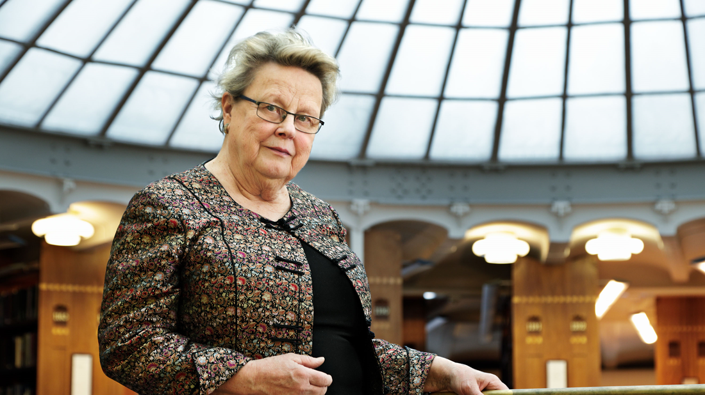
Thank you for listening and watching our presentation
We hoped you enjoyed it, have a nice day - best regards from Viktoria and Venla

